Slide 1

Differential Privacy
REU Project Mentors:
Darakhshan Mir
James Abello
Marco A. Perez

Slide 2

In an ideal world…
We would like to be able to study data as freely as possible

Slide 3
What is Differential Privacy?
One’s participation in a statistical database should not disclose any more information that would be disclosed otherwise.

Slide 4
Key Concepts
Neighboring databases can only differ by, at most, one entry.
x
x'
ID | Age
Martin | 24
Neel | 29
Marco | 21
Ming | 23
ID | Age
Martin | 24
Neel | 29
Marco | 21

Slide 5
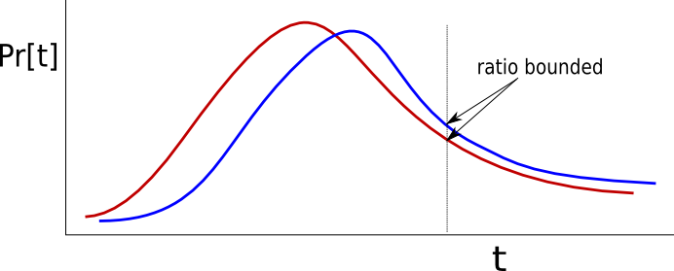
Definitions
ε-Differential Privacy

Slide 6
Definitions
Global Sensitivity
GS of f, is the maximum change in f over all neighboring instances
    GS_{f} ≤ |f(x)-f(x')|

Slide 7
Question!
Assume f is the query How many people are 23 years old, can you compute the global sensitivity?
x
x'
ID | Age
Martin | 24
Neel | 29
Marco | 21
Ming | 23
ID | Age
Martin | 24
Neel | 29
Marco | 21

Slide 8
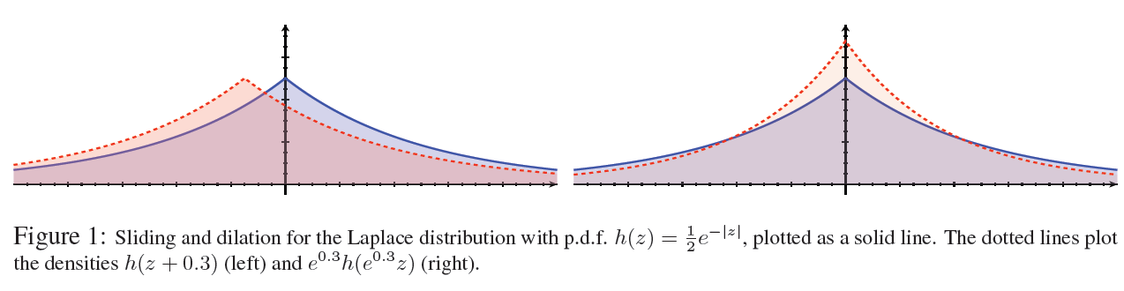
Adding Noise
Laplace Distribution and its properties

Slide 9
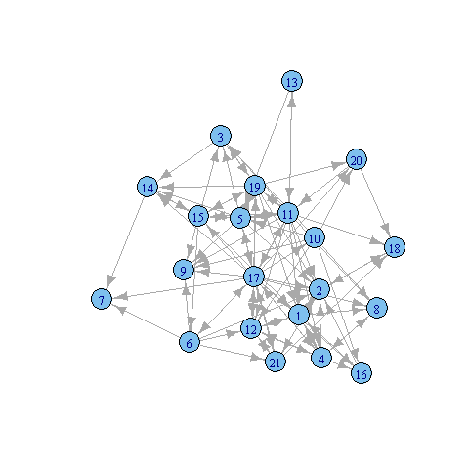
Differential Graph Privacy
The same definition of privacy can be applied to graphs.

Slide 10
Types of Differential Graph Privacy
Node-differential Privacy
two graphs are neighbors if they differ by at most one node and all of its incident edges.
Edge-differential Privacy
Two graphs are neighbors if they differ by at most one edge

Slide 11
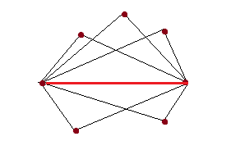
When Global Sensitivity Fails
The maximum amount, over the domain of the function, that any single argument to f can change the output.

Slide 12
Other types of Sensitivity
Local Sensitivity
Smooth Sensitivity

Slide 13
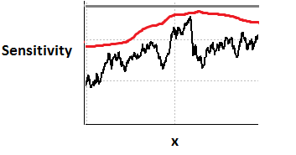

Graphical Representation

Slide 14
Smooth Sensitivity of Triangles in Random Graph Models
Stochastic Kronecker Graphs
Exponential Random Graph Model

Slide 15
Future Work
Theoretically describe the growth of smooth sensitivity in the mentioned random graph models.
Study graph transformations from a Differentially Private perspective and their implementation

